Slide 1
Sales and Customer Analysis using MySQL
Sridharan S

Slide 2
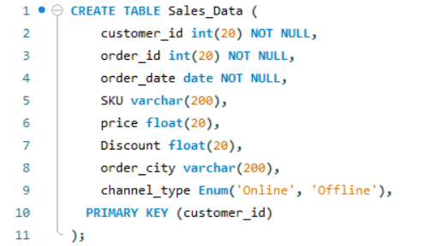
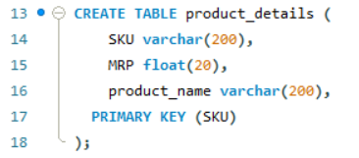
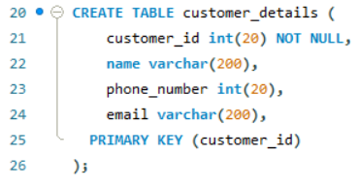
Overview of Dataset
Dataset contains three tables
Sales data
Customers data
Products data
Each table is created in MySQL and entries are imported using .csv
Table 1: Sales_Data
Table 2: product_details
Table 3: customer_details

Slide 3
Data sets
Table 1: Sales_Data
Table 2: product_details
order_id | customer_id | order_date | SKU | Price | Discount | Order_city | Channel_type
1 | 1 | 2024-11-04 | ST,3 | 4788 | 10 | Greek | Online
2 | 1 | 2024-11-08 | ST,2 | 1285 | 20 | Greek | Online
3 | 1 | 2024-12-02 | CR,3 | 1849 | 30 | Greek | Offline
4 | 1 | 2024-12-10 | CR,3 | 1359 | 50 | Greek | Offline
5 | 1 | 2024-12-12 | CR,3 | 8475 | 10 | Greek | Offline
6 | 2 | 2024-11-06 | ST,1 | 2797 | 30 | US | Online
7 | 2 | 2024-11-24 | CR,1 | 3177 | 40 | US | Offline
8 | 2 | 2024-12-04 | CR,2 | 2702 | 30 | US | Offline
9 | 2 | 2024-12-08 | CR,1 | 2045 | 20 | US | Offline
10 | 3 | 2024-11-12 | ST,2 | 8329 | 30 | India | Online
11 | 3 | 2024-12-06 | CR,1 | 7500 | 50 | India | Offline
12 | 4 | 2024-11-10 | ST,2 | 4679 | 20 | Rome | Online
13 | 5 | 2024-11-14 | ST,3 | 1604 | 50 | US | Online
14 | 7 | 2024-11-16 | ST,2 | 8644 | 40 | Ice land | Online
15 | 7 | 2024-11-20 | ST,3 | 1172 | 40 | Ice land | Online
16 | 7 | 2024-11-22 | CR,1 | 2540 | 10 | Ice land | Offline
17 | 8 | 2024-11-18 | ST,1 | 7142 | 20 | Hogwarts | Online
18 | 8 | 2024-11-26 | CR,3 | 4486 | 20 | Hogwarts | Offline
19 | 9 | 2024-11-28 | CR,3 | 3548 | 20 | Japan | Offline
20 | 10 | 2024-11-30 | CR,3 | 2373 | 30 | Caribbean | Offline
SKU | MRP | product_name
ST,1 | 100 | Steelium
ST,2 | 200 | Optigal
ST,3 | 300 | Galvalume
CR,1 | 400 | Ceralium
CR,2 | 500 | Ceragal
CR,3 | 600 | Ceralume
Table 3: customer_details
customer_id | name | Phone_number | Email
1 | Alexander | 7419254754 | Alexanderhistory@bmail.com
2 | Barney | 8413935996 | Barneyseries@bmail.com
3 | Charlie | 5206761141 | Charliecomic@bmail.com
4 | David | 2054473762 | Davidcomic@bmail.com
5 | E Wall | 2080768259 | E Wallmovie@bmail.com
6 | Froest Gump | 3563377668 | Froest Gumpmovie@bmail.com
7 | Godfrey | 3124177590 | Godfreygot@bmail.com
8 | Hermione | 3751357758 | Hermionehp@bmail.com
9 | Iroh | 4209817379 | Irohanime@bmail.com
10 | Jack Sparrow | 7000475016 | Jack Sparrowmovie@bmail.com
Note: SKUs should be alpha-numeric codes for products belonging in 2 categories, steel starting with ST and ceramic starting with CR. channel_type (can be either ‘online’/’offline’ only)

Slide 4
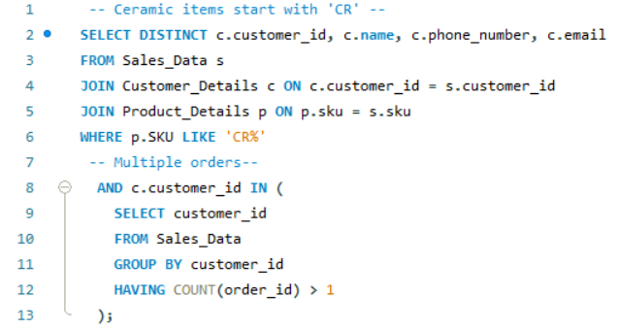
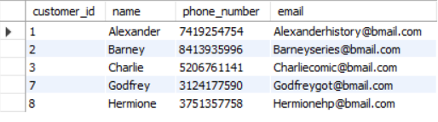
Query 1:
Name and list the details of all customers who have placed multiple orders and have purchased a ceramic item at least once.
MySQL query:
Output:

Slide 5
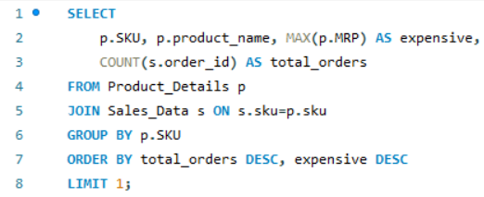

Query 2:
Find the most expensive bestseller
MySQL query:
Output:

Slide 6
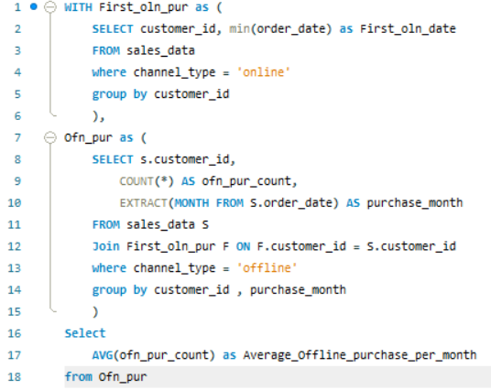

Query 3:
For all customers who have purchased for the first time online, calculate the average number of times they purchase offline in a month
MySQL query:
Output:

Slide 7
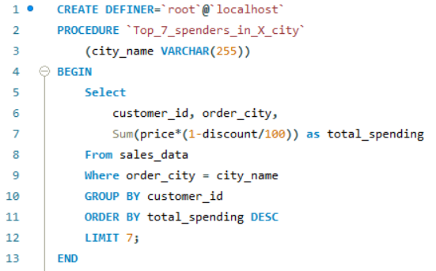
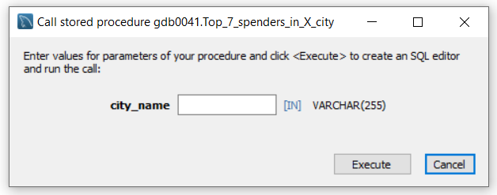
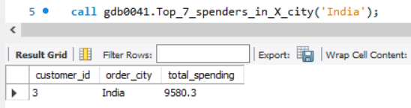
Query 4:
List the top 7 spenders in Y city (here Y should be a user-input variable)
MySQL query:
Output:

Slide 8
Thank You

